Slide 1
Feature Selection

Slide 2
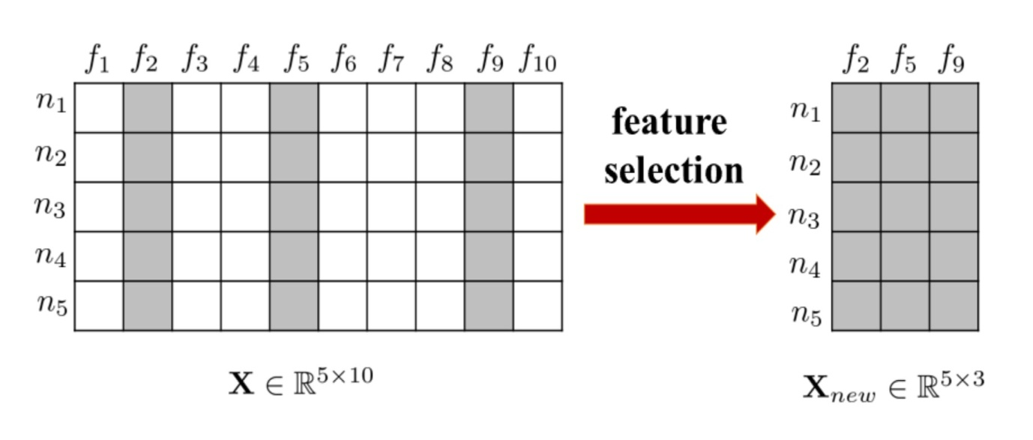
Feature Selection
It is the process of selecting a subset of relevant features for use in model construction.
It is also called variable selection or attribute selection.
It reduces the complexity of model.
It either improve or maintain accuracy of model.

Slide 3
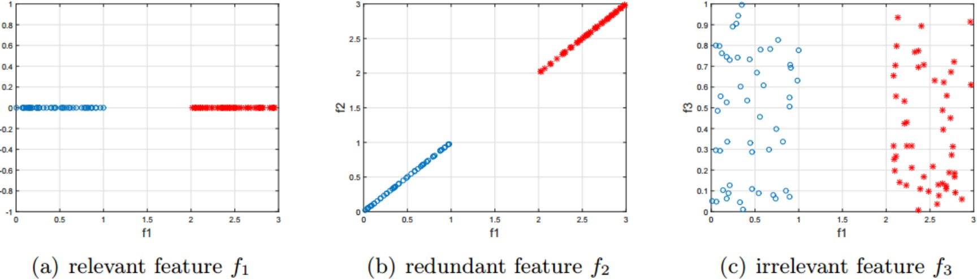
Relevant vs. Redundant features
Feature selection keeps relevant features for learning and removes redundant and irrelevant features
For example, for a binary classification task (f1 is relevant; f2 is redundant given f1; f3 is irrelevant)

Slide 4
Feature Extraction vs. Feature Selection
Commonalities
Speed up the learning process
Reduce the storage requirements
Improve the learning performance
Build more generalized models
Differences
Feature extraction obtains new features while feature selection selects a subset of original ones
Feature selection maintains physical meanings and gives models better readability and interpretability

Slide 5
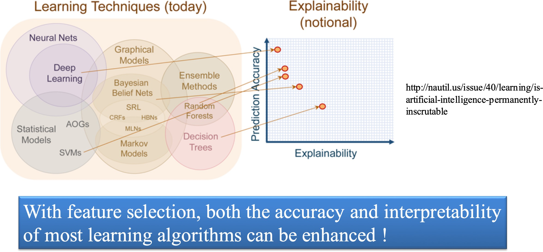
Interpretability of Learning Algorithms

Slide 6
When feature selection is important?
Noisy data
Lots of low frequent features
Use multi-type features
Too many features comparing to samples
Complex model
Samples in real scenario is inhomogeneous with training & test samples

Slide 7
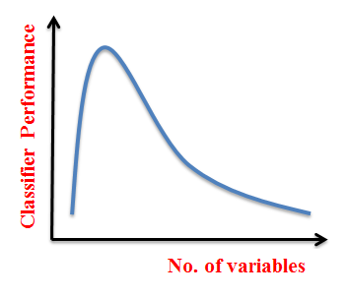
Curse of Dimensionality
The amount of data required to achieve the same level of accuracy increases exponentially as the number of features increases.
But in practice, the volume of training data available to us is fixed. Therefore, in most cases, the performance of the classifier will decrease with an increased number of variables.

Slide 8
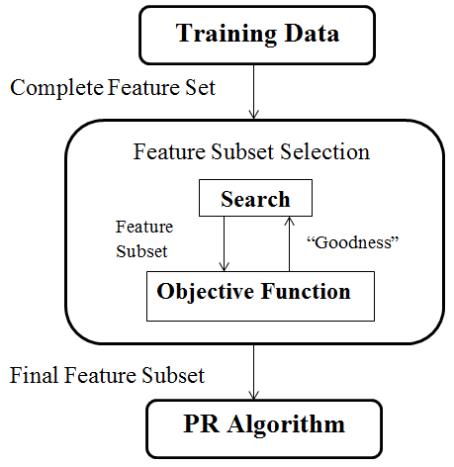
Feature Selection Steps
Feature Selection is an optimization problem.
Step 1 : Search the space of possible feature set.
Step 2 : Pick the subset that is optimal or near optimal with respect to some objective function.

Slide 9
Feature Selection Algorithms
From the label perspective (whether label information is involved during the selection phase):
Supervised
Unsupervised
Semi-Supervised
From the selection strategy perspective (how the features are selected):
Wrapper methods
Filter methods
Embedded methods

Slide 10
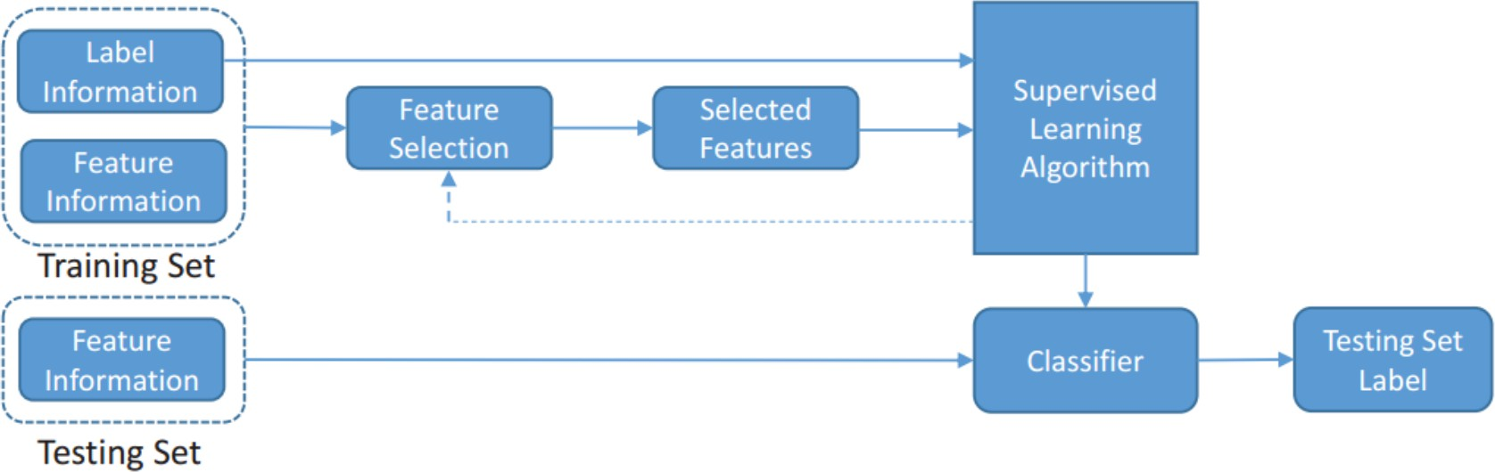
Supervised Feature Selection
Supervised feature selection is often for classification or regression problems
Find discriminative features that separate samples from different classes (classification) or approximate target variables (regression)

Slide 11
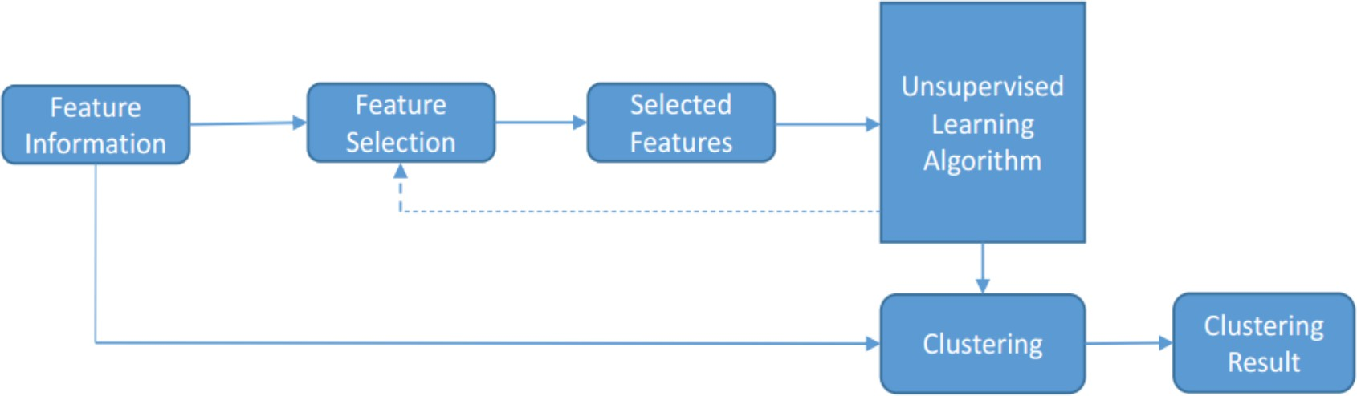
Unsupervised Feature Selection
It is often for clustering problems
Label information is expensive to obtain which requires both time and efforts
Unsupervised methods seek alternative criteria to define feature relevance

Slide 12
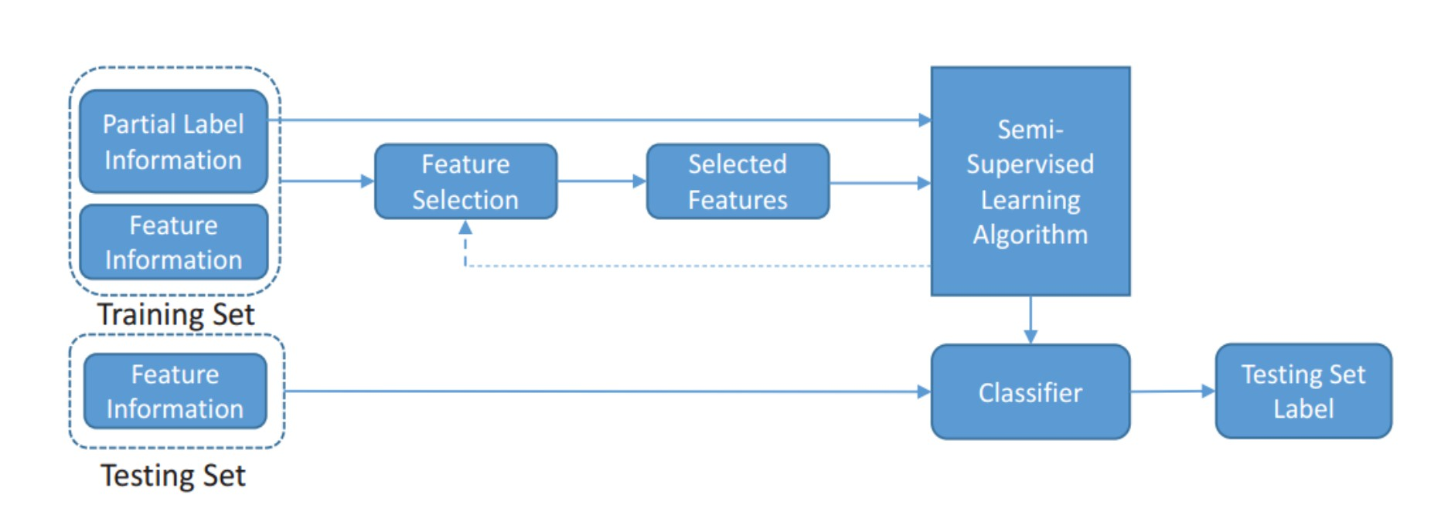
Semi-Supervised Feature Selection
We often have a small amount of labeled data and a large amount of unlabeled data
Semi-supervised methods exploit both labeled and unlabeled data to find relevant features

Slide 13
Feature Selection Methods
Feature Selection Algorithms can be broadly classified into 3 classes :
Filter Methods
Wrapper Methods
Embedded Methods

Slide 14
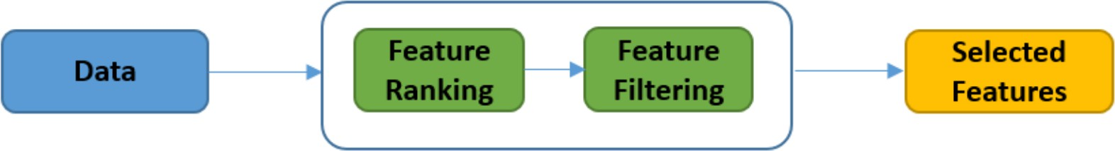
Filter Methods
purely Statistical in nature.
used as a preprocessing step.
the selection of features is independent of any machine learning algorithms.
features are selected on the basis of their scores in various statistical tests for their correlation with the outcome variable.

Slide 15
Filter Method Techniques
LDA: Linear discriminant analysis is used to find a linear combination of features that characterizes or separates two or more classes (or levels) of a categorical variable.
ANOVA: ANOVA stands for Analysis of variance. It is similar to LDA except for the fact that it is operated using one or more categorical independent features and one continuous dependent feature. It provides a statistical test of whether the means of several groups are equal or not.
Chi-Square: It is a dependency test which helps us to determine either there is any kind of dependence among the variables under observation or not.
Pearson’s Correlation: It is used as a measure for quantifying linear dependence between two continuous variables X and Y. Its value varies from -1 to +1.

Slide 16
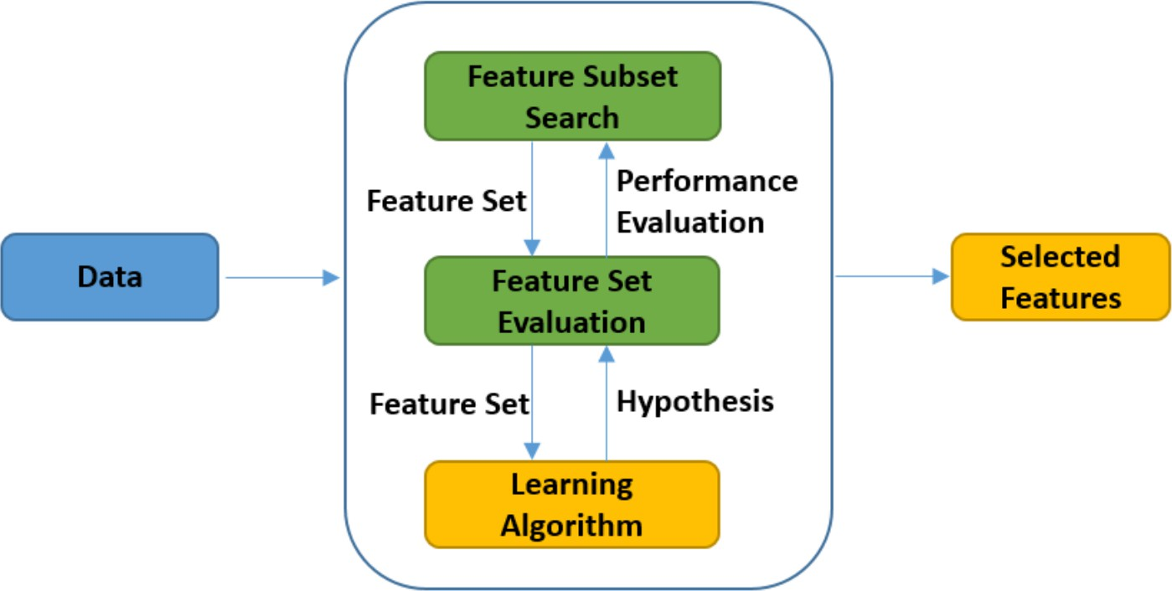
Wrapper Method
work on the basic principles of Combinatorics.
the learning algorithm (classifier) itself is used to perform the Feature Selection and select the top features.
Examples :
forward feature selection
backward feature elimination

Slide 17
Forward Selection: Forward selection is an iterative method in which we start with having no feature in the model. In each iteration, we keep adding the feature which best improves our model till an addition of a new variable does not improve the performance of the model.
Backward Elimination: In backward elimination, we start with all the features and removes the least significant feature at each iteration which improves the performance of the model. We repeat this until no improvement is observed on removal of features.

Slide 18
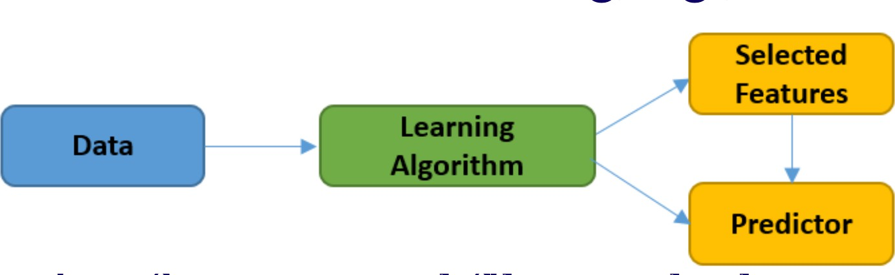
Embedded Methods
combine the qualities of filter and wrapper methods.
dynamic Feature Selection Methods.
Inherit the merits of wrapper and filter methods
Include the interactions with the learning algorithm
More efficient than wrapper methods
Like wrapper methods, they are biased to the underlying learning algorithms

Slide 19
Selection Criteria
Traditional Feature Selection
Similarity based methods
Information Theoretical based methods
Sparse Learning based methods
Statistical based methods

Slide 20
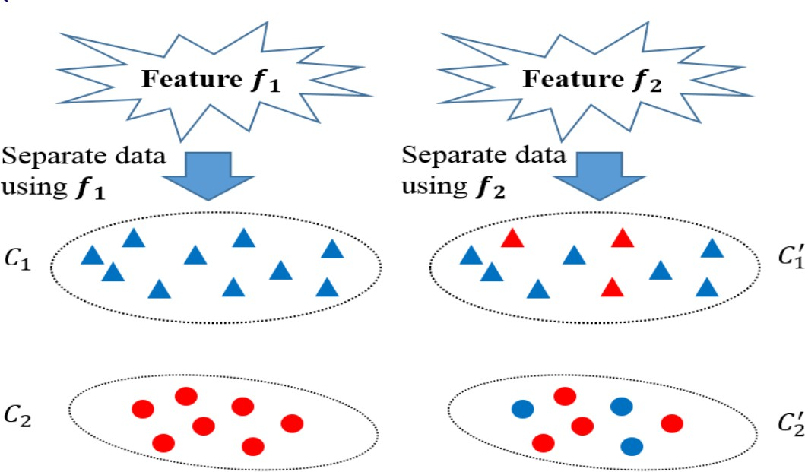
Similarity based Feature Selection
Similarity based methods assess the importance of features by their ability to preserve data similarity
A good feature should not randomly assign values to data instances
A good feature should assign similar values to instances that are close to each other – (the “closeness” is obtained from data similarity matrix)
Different shapes denote different values assigned by a feature

Slide 21

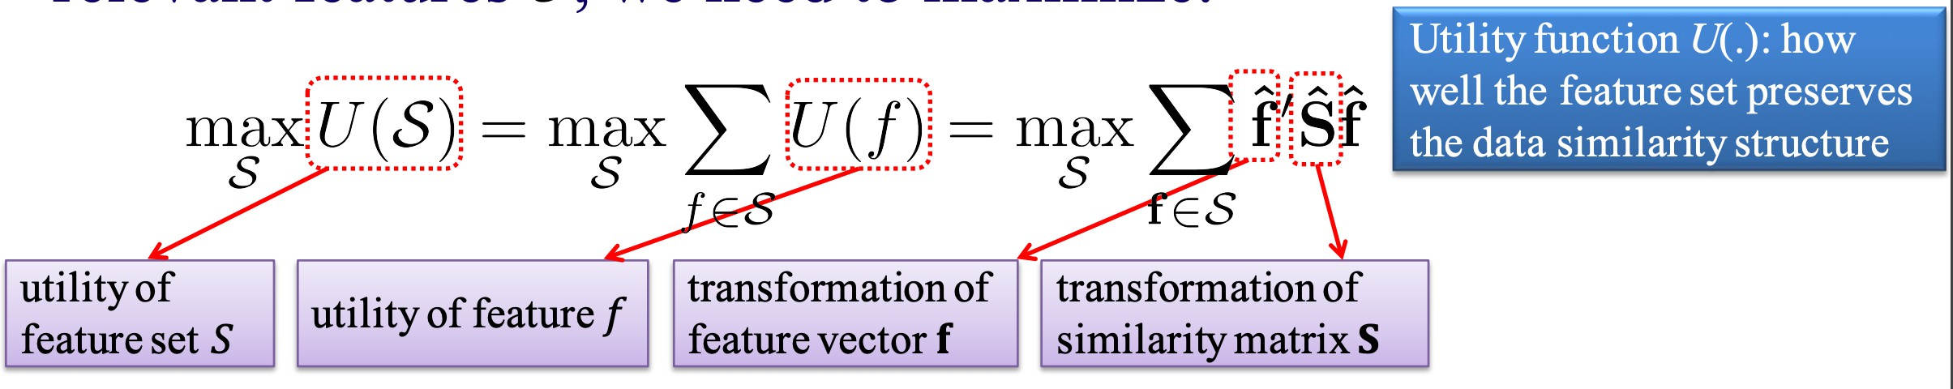



Similarity based Methods – A General Framework
Suppose data similarity matrix is to find the most relevant features , we need to maximize:
It is often solved by greedily selecting the top features that maximize their individual utility
•
Different methods vary in the way how the vector f and similarity matrix S are transformed to and

Slide 22
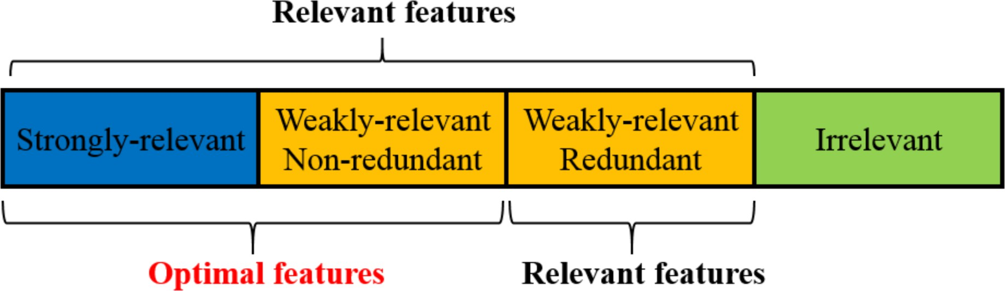
Information Theoretical based Methods
Exploit different heuristic filter criteria to measure the importance of features
Our target is to find these “optimal” features

Slide 23

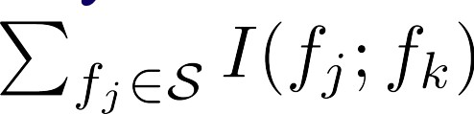
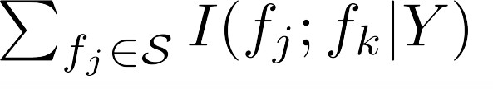
Information Theoretic based Methods - A General Framework
Searching for the best feature subset is NP-hard, most methods employ forward/backward sequential search heuristics
E.g., for forward search, given selected features S, we should do the following for the next selected feature
– Maximize its correlation with class labels Y:
– Minimize the redundancy w.r.t. selected features in S:
– Maximize its complementary info w.r.t. selected features in S:

Slide 24
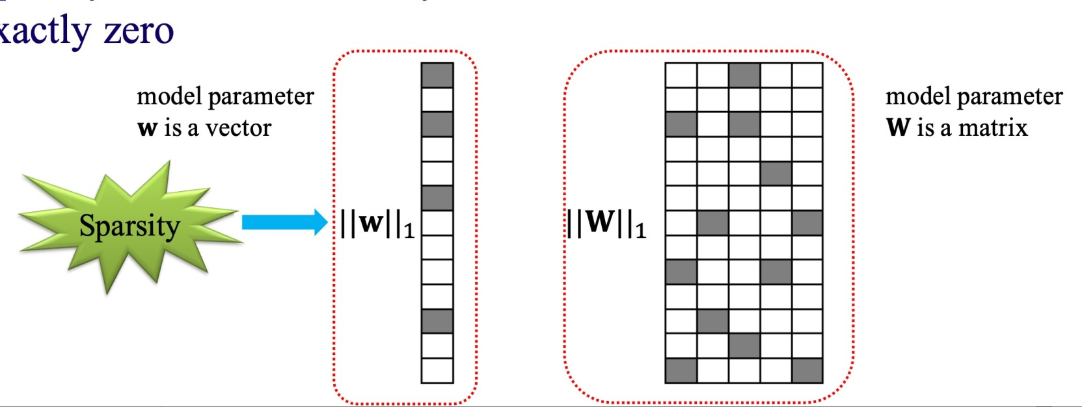
Sparse learning based methods
What is Feature Sparsity?
The model parameters in many data mining tasks can be represented as a vector w or a matrix W
Sparsity indicates that many elements in w and W are small or exactly zero

Slide 25
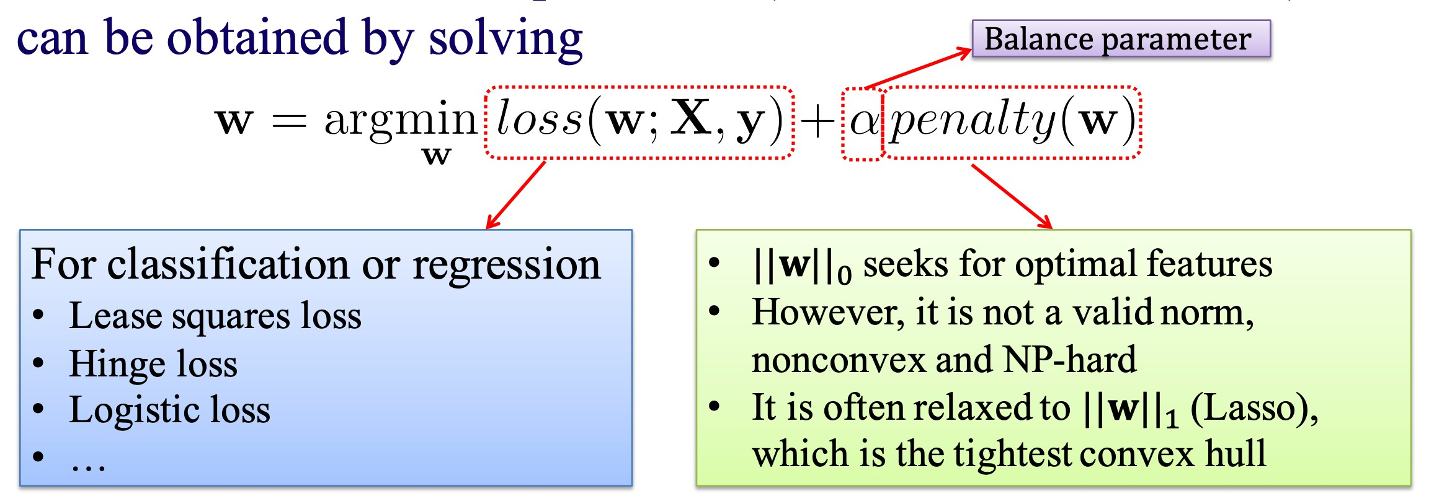
Sparse Learning Methods - A General Framework
Let us start from the binary classification or the univariate regression problem
Let w denote the model parameter (a.k.a. feature coefficient), it can be obtained by solving

Slide 26
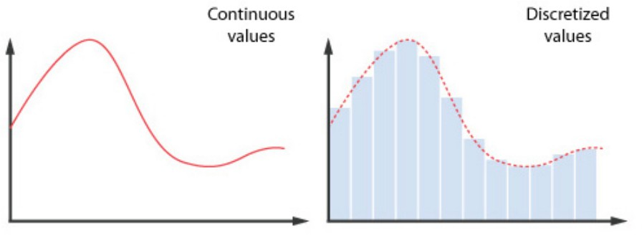
Statistical based Methods
This family of algorithms are based on different statistical measures to measure feature importance
Most of them are filter feature selection methods
Most algorithms evaluate features individually, so the feature redundancy is inevitably ignored
Most algorithms can only handle discrete data, the numerical features have to be discretized first.

Slide 27
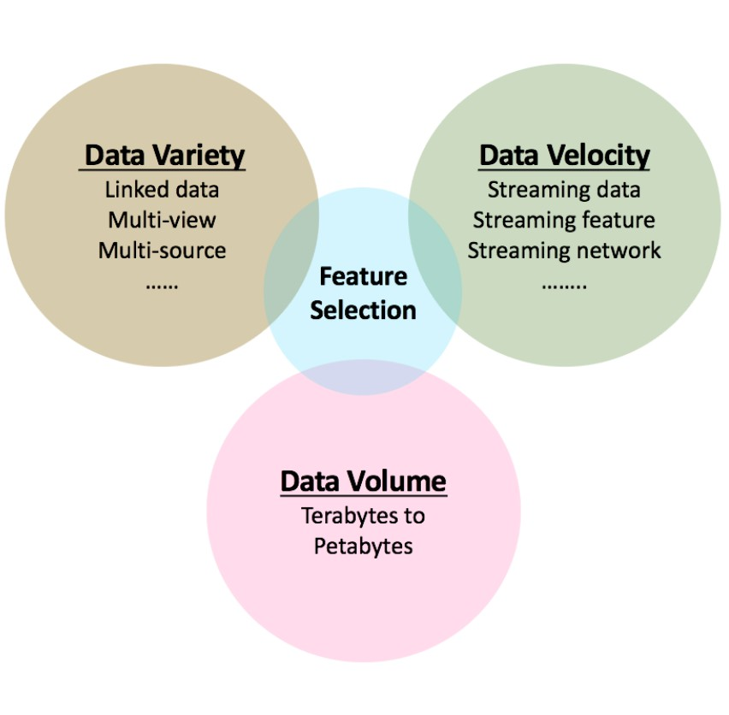
Feature Selection Issues
Recent popularity of big data presents challenges to conventional FS
Streaming data and features
Heterogeneous data
Structures between features
Volume of collected data

Slide 28
What is Dimensionality Reduction?
Definition: Dimensionality Reduction is the process of reducing the number of input features (variables) while preserving as much useful information as possible.
Why is it Needed?
When the number of features increases:
Data becomes sparse
Distance between data points increases
Similarity calculations become less meaningful
Models require more training data
Training becomes slower
Risk of overfitting increases

Slide 29
Example - Suppose a student dataset contains:
Age Gender Attendance Marks Sports Family Income Internet Usage Travel Distance ...
Instead of using 100 features, we may reduce them to 10–20 important features.
This phenomenon is called the Curse of Dimensionality.

Slide 30
Feature Selection
Definition: Feature Selection is the process of selecting the most relevant features from the original dataset and removing irrelevant or redundant features.
Key Idea
The original features remain unchanged. We simply choose the most useful ones.
Example
Original Features:
Age Gender Height Weight Student ID Phone Number
Selected Features: Age, Height, Weight
Student ID and Phone Number may not help prediction.
Advantages
Simpler models
Faster training
Reduced overfitting
Better interpretability

Slide 31
Feature Extraction
Definition: Feature Extraction creates new features by combining information from the original features.
Key Idea
Instead of removing features, we transform them into a new lower-dimensional representation.
Example
Original Features: Math Score, Reading Score, Writing Score
After PCA: Principal Component 1, Principal Component 2
These components summarize most of the information.

Slide 32
Benefits of Dimensionality Reduction
1. Faster Training - Fewer features mean less computation.
2. Reduced Storage - Smaller datasets require less memory.
3. Better Generalization - Removes irrelevant features and reduces overfitting.
4. Improved Visualization - High-dimensional data can be projected into 2D or 3D for visualization.
5. Noise Reduction - Removes noisy and redundant information.
6. Better Model Performance - Models focus on the most informative features.

Slide 33
Major Dimensionality Reduction Techniques
PCA
Backward Feature Elimination
Forward Feature Selection
Low Variance Filter
High Correlation Filter
Decision Trees
Random Forest
Factor Analysis
Most Popular Technique - PCA (Principal Component Analysis) is the most widely used dimensionality reduction technique for reducing features while preserving maximum variance.

Slide 34
How do you do a PCA?
Steps of PCA
Standardize the range of continuous initial variables.
Compute the covariance matrix to identify correlations.
Compute the eigenvectors and eigenvalues of the covariance matrix to identify the principal components.
Create a feature vector to decide which principal components to keep.
Recast the data along the principal component axes.

Slide 35
Exercise
Consider the following two-dimensional patterns
(2,1) (3,5) (4,3) (5,6) (6,7) (7,8)
Compute the principal component using the PCA algorithm.

Slide 36
Get Data
Given Feature Vectors - x1 = (2,1) x2 = (3,5) x3 = (4,3) x4 = (5,6) x5 = (6,7)
x6 = (7,8)
Data Matrix:
[2] [1] [3] [5] [4] [3] [5] [6] [6] [7] [7] [8]

Slide 37
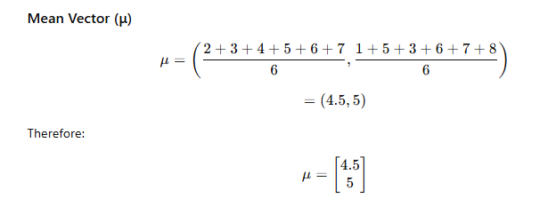
Calculate Mean Vector

Slide 38
Subtract Mean Vector
Centered Data
x1−μ=(2−4.5, 1−5)=(−2.5,−4)
x2−μ=(3−4.5, 5−5)=(−1.5,0)
x3−μ=(4−4.5, 3−5)=(−0.5,−2)
x4−μ=(5−4.5, 6−5)=(0.5,1)
x5−μ=(6−4.5, 7−5)=(1.5,2)
x6−μ=(7−4.5, 8−5)=(2.5,3)
Centered Feature Vectors:
(-2.5,-4), (-1.5,0), (-0.5,-2), (0.5,1), (1.5,2), (2.5,3)

Slide 39
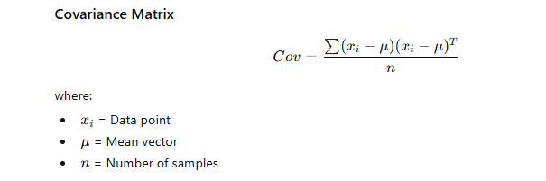
Covariance Matrix Formula

Slide 40
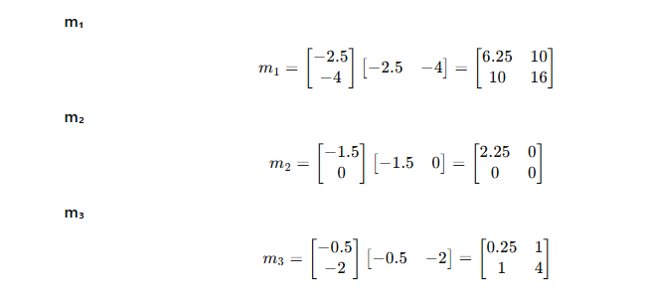
Calculate Individual Matrices

Slide 41
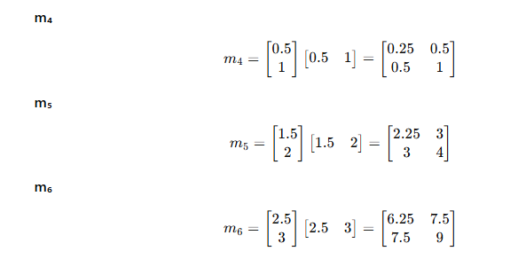

Slide 42
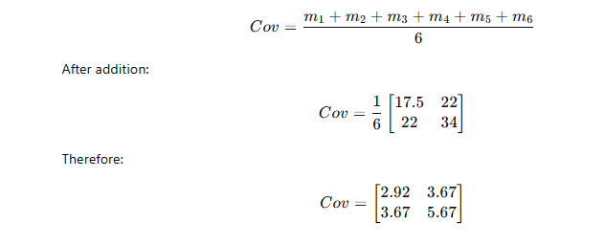
Final Covariance Matrix

Slide 43
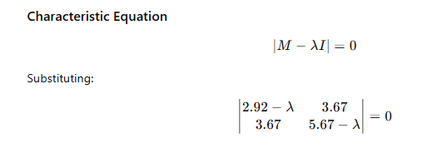
Calculate Eigenvalues

Slide 44
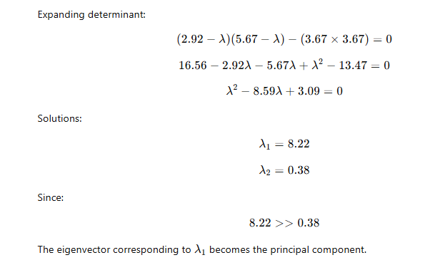
Solve Eigenvalues

Slide 45
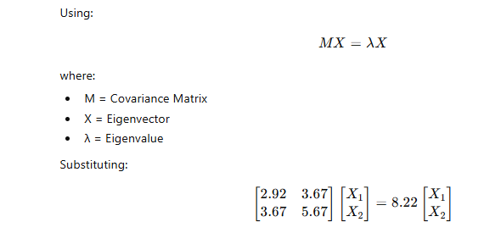
Calculate Eigenvector

Slide 46
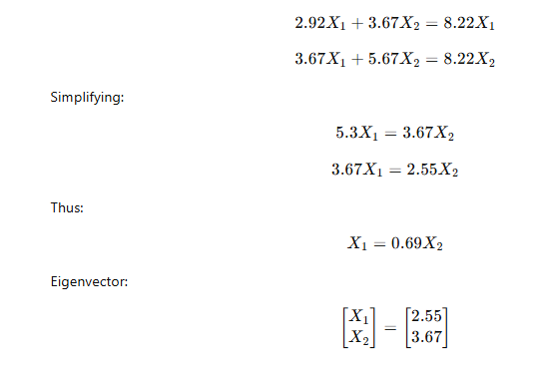
Solve Eigenvector

Slide 47

Principal Component
Principal Component:
Projected values:
8.77 26.00 21.21 34.77 40.99 47.21

Slide 48
Thank You !

